Slide 1

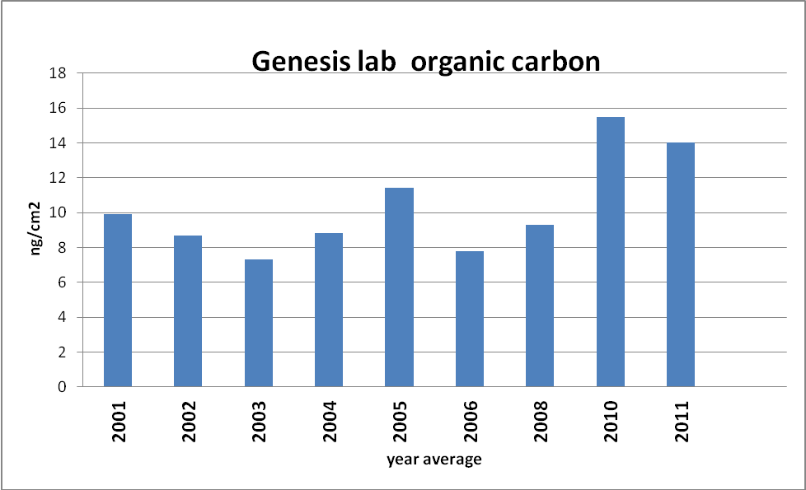
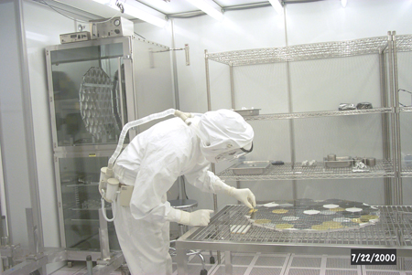
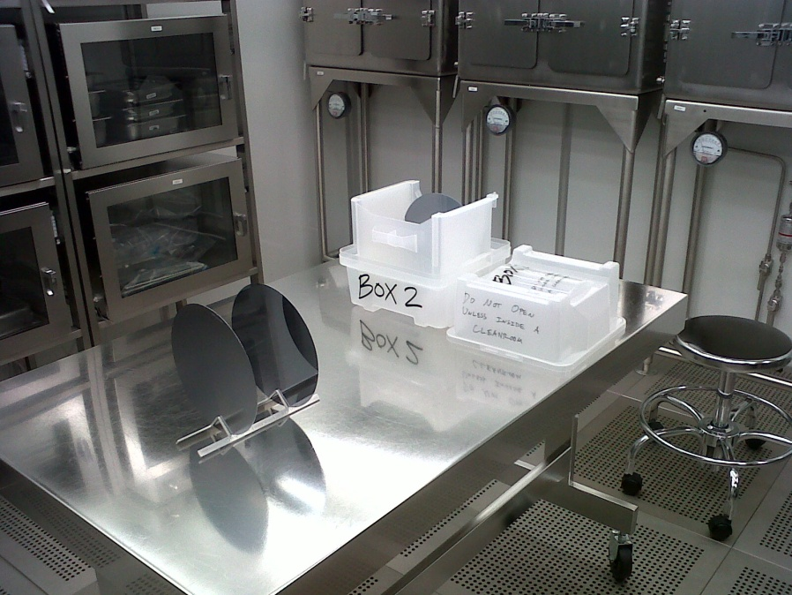


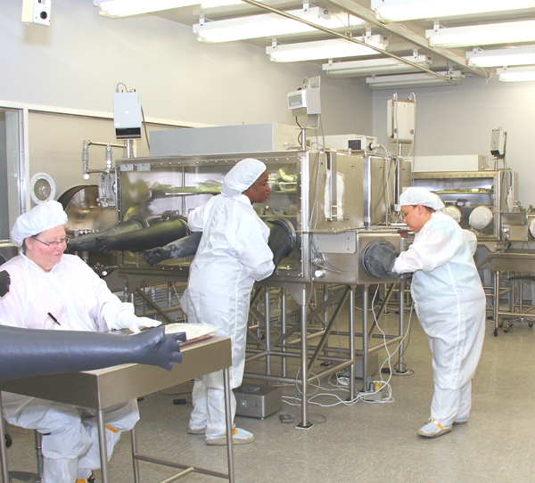
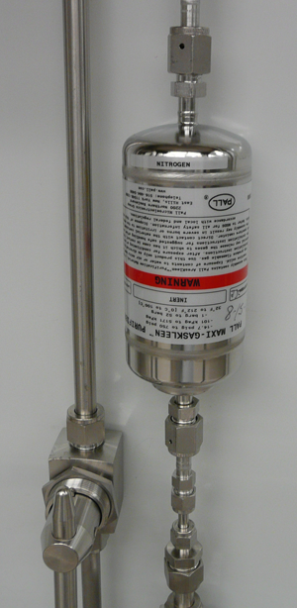
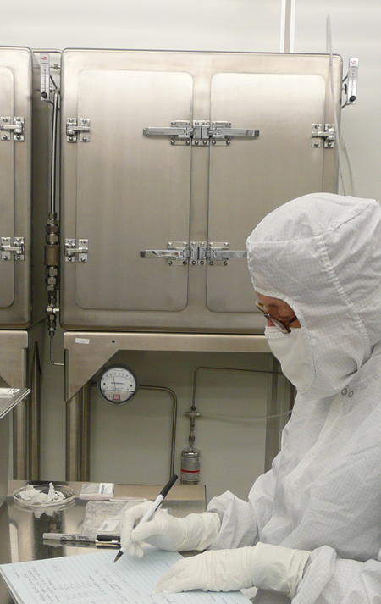
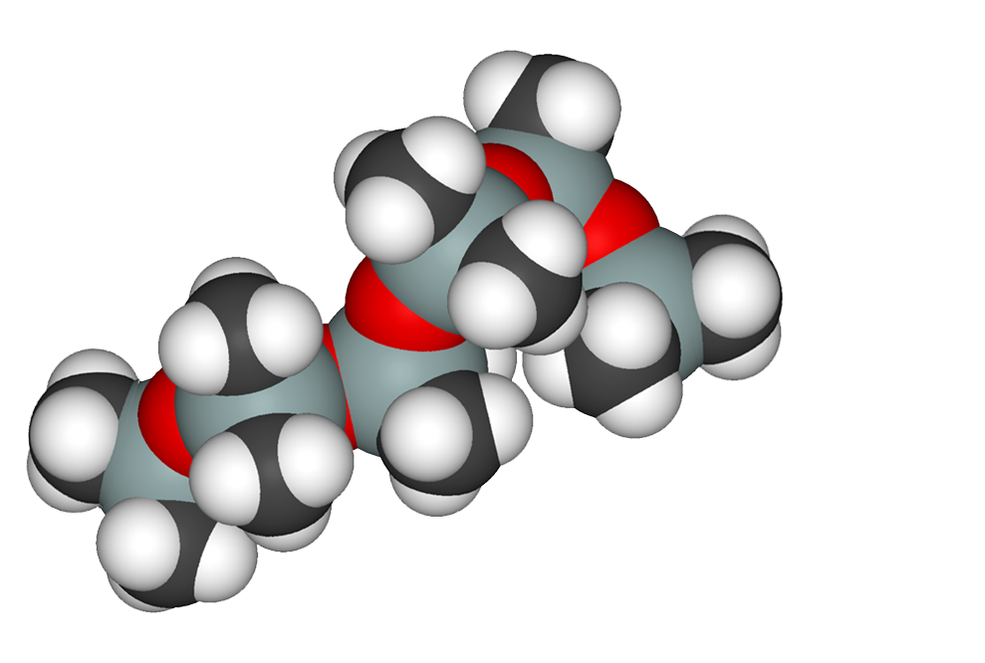
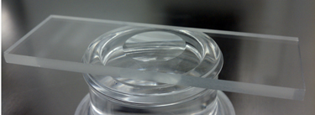
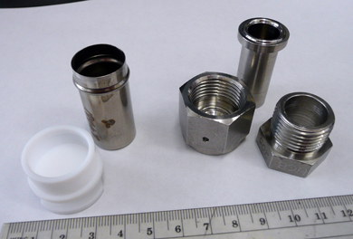
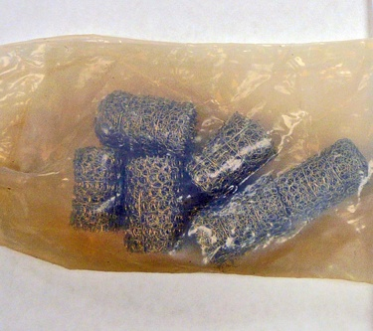
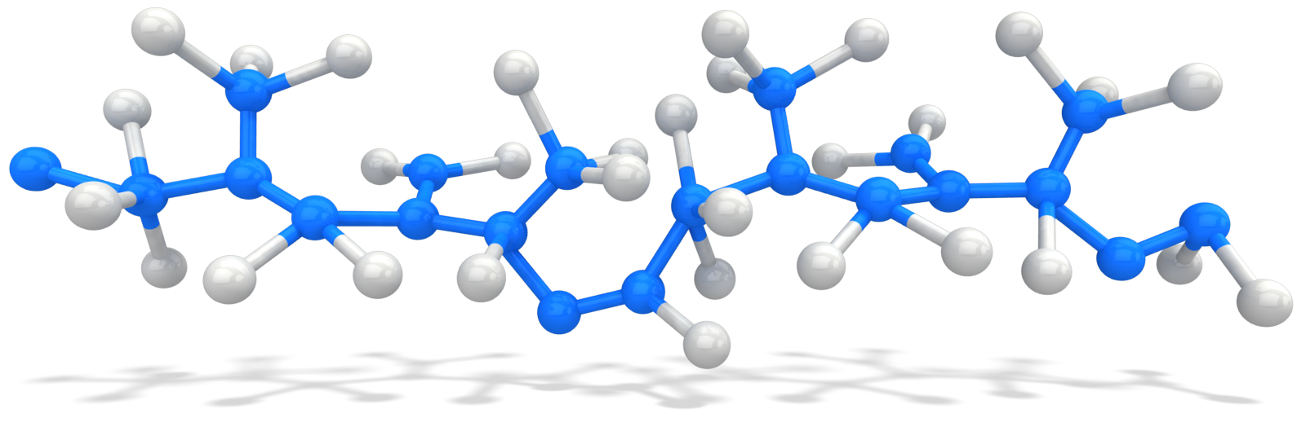



Apollo Lunar Sample Return performed organic monitoring
The first mission resulted in higher organic contamination to samples than desired.
Improvements were by Apollo 12 [1].
Quarantine complicated the goal of achieving organic cleanliness
Requiring negative pressure glovebox containment
Proximity of animal, plant and microbial organic sources, and use of organic sterilants.
A special Low Organic Laboratory at University of California Berkeley (UCB) achieved clean subdivision of a subset of samples [2, 3, 4].
The basic approach of handling rocks and regolith inside of a positive pressure stainless steel glovebox and restricting tool and container materials was established by the last Apollo sample return, Apollo 17.
In the last 40 years, the collections now encompass Antarctic meteorites, Cosmic Dust, Genesis solar wind, Stardust comet grains and Hayabusa asteroid grains.
Each collection has unique curation requirements for organic contamination monitoring and control driven by improved technology, changes in environmental regulations and economy.
Future sample return missions - OSIRIS-Rex, Mars, comets - require extremely low levels of organic contamination during sample collection and curation.
JSC Curation is documenting current organic baselines and testing new ways to reduce organic contamination.
CLEANING with ULTRAPURE WATER
Freon 113 previously used for degreasing tools and containers- but phased out.
- removed organic contaminants with little hydrocarbon residue
UPW- mid 1990’s ultrapure water used as active solvent- nonflammable - ionic concentrations in the very low parts per trillion
- total oxidizable carbon (TOC) under 5 ppb,
- produced at 8 gal/min in a constantly flowing system
- tool cleaning performed under constant flow using ultrasonic or megasonic energy
Results in very low particle tools and containers [5].
EXAMPLE: final rinse water analysis for flushing a stainless steel glovebox with about
50 gallons of heated UPW showed 1) no particles >1mm size per liter,
2) TOC of 40 ppb, 3) only 1 cation -Fe (0.16 ppb) and 4) 4 anions: F, Cl, SO4, and PO4 (<1ppb).
Need Method for Verification of Surface Organic Cleanliness.
Airborne Molecular Contamination (AMC) Monitoring
- Genesis Lab monitoring since 1998 using Polished Silicon Wafers
- Used when samples handled directly in air versus nitrogen-filled gloveboxes
Important for laboratories using particle-filtered HEPA or UPLA filtration
which offgas RTV compounds.
Example: Genesis laboratory, with 54 ULPA and HEPA fan filter units supplied by a HEPA filtered air handler, deposits 10 ng/cm² on a 24-hour witness wafer. The composition is mostly siloxanes from the RTV and plasticizers. This technique captures the higher molecular weight species, likely to “stick” to sample surfaces.
Molecular contamination in laboratories and gloveboxes has been measured using sorbents capturing more volatile species.
Polished Silicon Wafer use inside of gloveboxes assesses glovebox nitrogen environment including offgasing during heat sealing of sample bags. [6,7]
A combined heat sealing test of Teflon®, nylon, and polyethylene inside of nitrogen-filled glove box produced caprolactam (1300 ng/cm² from nylon), and lesser amounts of N,N-dibutylformamide, dibutyl phthalate, cyclo(Me₂SiO)₈, N,N-dibutylacetamide.
CLEANER NITROGEN
Pure Nitrogen supplied to gloveboxes and sample storage desiccators
Curation has 43 gloveboxes and 77 storage desiccators
Curation uses 1000 tons of liquid nitrogen per year,
produced from boil off of Grade C liquid nitrogen which is low in argon
point-of-use gas purifier/filters scrub to < 1 ppb H2O, O2, CO2, CO and retain particles > 3 nm --- but are expensive and long-term effects need to be evaluated
Variety in containers
Initial organic free containers developed at UCB from stainless steel vacuum flanges
Early low organic containers for use in curation processing were made from drawn stainless steel with Teflon snap caps.
Stardust and Hayabusa -- a dimpled glass slide sandwich
The Challenge is for Development of Organic-Free Containers for
Fragile Samples During Shipping
need to replace plastics seals and dunnage
Impurity | Specification, ppm | Analysis, ppm
O | 10 | 0.1
Ar | 20 | 9.33
CO2 | 10 | 0.1
CO2 | 10 | 0.1
H | 10 | 0.1
total hydrocarbon | 1 | 0.1
water | 10 | 0.185
left - drawn SS container w/ Teflon snap cap currently used in JSC curation for rock and regolith (lunar and meteorite).
right - UCB low organic container fabricated from stainless steel vacuum flange (3 pieces). Scale is in cm
above - small Stardust and Hayabusa grains are cleanly contained when placed in a dimpled glass slide sandwich.
More efficient airborne
particle distribution counting
Apollo Era - environmental airborne particle counts performed with witness plates
Today - hand-held airborne particle counters monitor all curation laboratories
weekly, also verifies integrity of HEPA and ULPA filters.
Variety in Witness Plates
Early Apollo Organic Witness Materials – easily subdivided
1) Woven Aluminum Mesh flown round trip to the Moon
2) Ottowa Sand used in glovebox processing simulations
Sandford et al., summarized organic contamination in Stardust samples and recommend a variety of witness materials easily subdivided for distribution [8].
Genesis and Stardust -some reference coupons were not easily subdivided.
Alternate Witness Materials for Laboratory Reference - Sapphire and CVD Diamond
Need Increased Availability of Witness Materials With Long Shelf Lives
suggested by rapid accumulation of contamination acquired during storage [9]
storage environment needs to be part of the discussion
References:
[1] Allton J.H. (1998) LPSXXIX, Abst. #1857.
[2]Burlingame A. et al (1970) Apollo 11 LSC, pp. 1779-1792.
[3] Burlingame A. et al (1971a) LSC2, pp. 1891-1900.
[4] Burlingame et al (1971b) UCB Space Sciences Laboratory, Organic Clean Room and Lunar Material Transfer Facilities, Univ. Calif. Berkeley.
[5] Allton J. H. et al. (2002) Cleaning Genesis Sample Return Canister for flight: Lessons for Planetary Sample Return, JSC-29742, 67 pp.
[6] Allton J. H. (2012) Conf. Life Detection in Extraterrestrial Samples., abst. #6028
[7] Schilling, E. and Schneider M. N. (1998) Workshop on Martian Met., abst. #7020.
[8] Sandford S. A. et al. (2010) Meteoritics and Planet. Sci., 45, Nr.3, 406-433.
[9] Kebukawa Y. et al. (2009) Meteoritics and Planet. Sci., 44, Nr.4, 545-557.
TOWARD LOWER ORGANIC ENVIRONMENTS IN ASTROMATERIAL SAMPLE CURATION FOR DIVERSE COLLECTIONS
J. H. Allton¹ , C. C. Allen¹, P. J. Burkett², M. J. Calaway², D. Z. Oehler¹, ¹NASA/Johnson Space Center, Astromaterials Curation, code KT, Houston,TX 77058, USA, judith.h.allton@nasa.gov, ²Jacobs (ESCG) at NASA Johnson Space Center, Houston, TX

